Slide 1
Process Control
Identification from Relay Feedback
Process Control
Dr. Cai Wenjian

Slide 2
Outline
  Fundamentals of Relay Feedback
    Generating Sustained Oscillation
    Approximate Transfer Functions: Simple method
    Approximate Transfer Functions: Fourier Transform Method
    Relay Plus Step
  Unconventional relay methods
    Time delay System
    Inverse Response System
    Open Loop Unstable Processes
Process Control
Dr. Cai Wenjian

Slide 3
Features of Relay Feedback
Time-saving, easy to use, automatically extracts the process response at an important frequency, facilitates simple push-button tuning
Test under closed-loop to keeps the process in the linear region (frequency response is of interest), good on highly nonlinear processes
No requirement for careful choice of the sampling rate from the a priori knowledge, useful in initializing a more sophisticated adaptive controller.
Can be modified to cope effectively with disturbances and perturbations to the process.
Process Control
Dr. Cai Wenjian

Slide 4
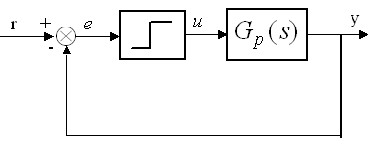
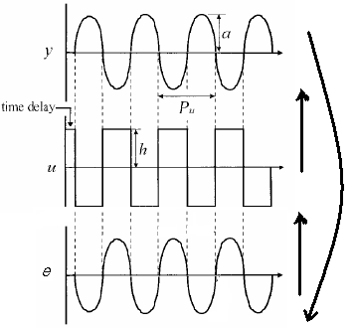
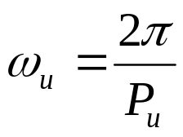
Generating Sustained Oscillation
Bring the system to steady-state
Increased u by h, (e.g., 5%)
After L, y increase, relay switches to opposite position,
As phase lag is -π, limit cycle a period P_{u} results.
Repeat to generate sustained oscillation
H, height of the relay;
a, amplitude of oscillation.
Process Control
Dr. Cai Wenjian

Slide 5

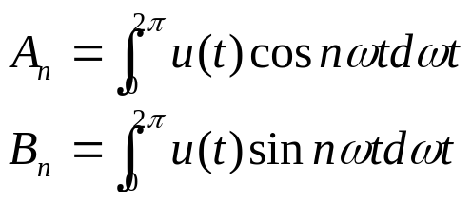
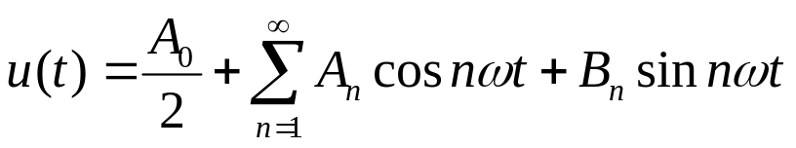
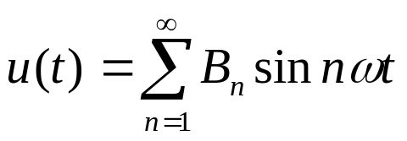
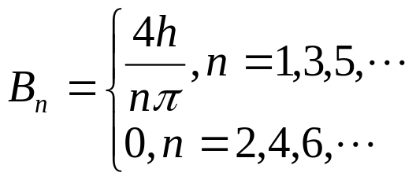
Fourier series Analysis
Input signal e(t) to the nonlinear element: sinusoidal wave:
output (u(t)) of nonlinear element: square wave:
u(t): odd-symmetric (N(a): un­biased and symmetric), A₀ and A_{n} zero
Process Control
Dr. Cai Wenjian

Slide 6
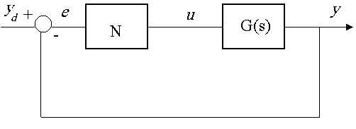
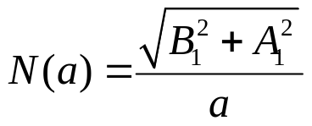
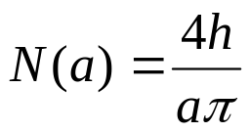
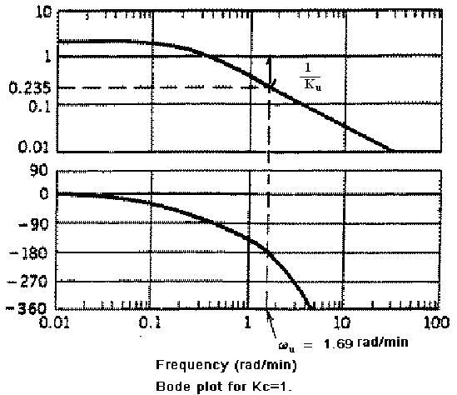


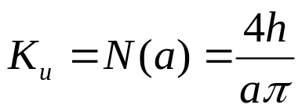
Ultimate Gain Analysis
Describing function for nonlinear system.
  only the first Fourier coefficient for frequency domain analysis.
For ideal relay, A₁ = 0, B₁ = 4h/π,
relay feedback oscillation frequency corresponds to limit of stability:
the ultimate gain (K_{u}) :
Process Control
Prof. Cai Wenjian

Slide 7
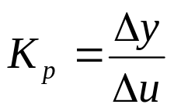
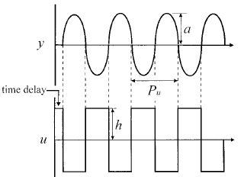
Time Delay and Steady-state Gain
K_{p:}compare input and output values at two different steady-states:
changes in u: small enough so it represents the linearized gain. highly nonlinear processes, changes as small as 10⁻³ to 10⁻⁶ percent of full range
  such small changes only feasible for mathematical steady-state gains
  impractical to obtain reliable steady-state gains from plant data.
Time delay L: read off from
initial part of relay feedback test.
Process Control
Dr. Cai Wenjian

Slide 8


Transfer function Modeling
Determine the model, back-calculation from gain and phase relation for parameters
Process Control
Dr. Cai Wenjian

Slide 9
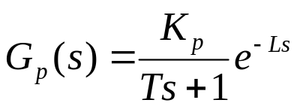
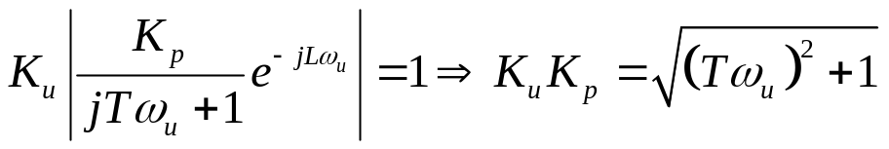
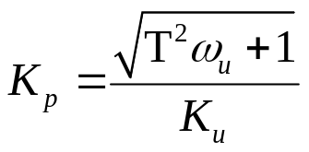


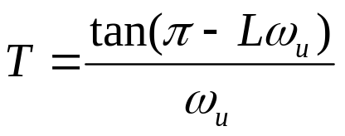

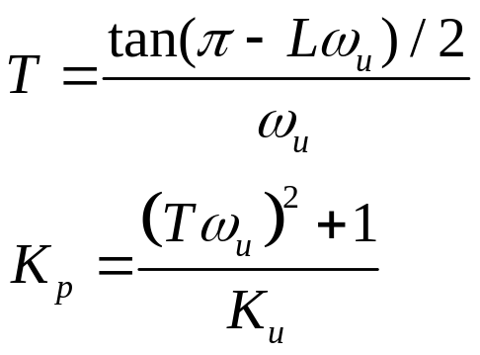
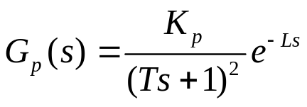
Example: Three Parameter Model
Using gain and phase condition at ultimate frequency
either L or K_{p} needed to solve for time constant, if L available, T, and K_{p}
Process Control
Dr. Cai Wenjian

Slide 10
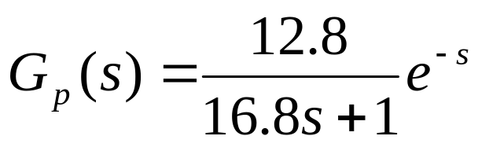
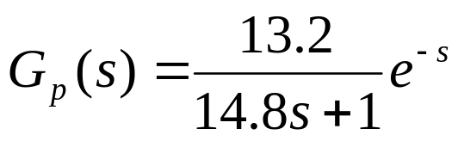
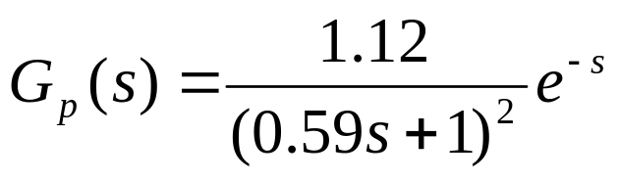
Example: Wood and Berry column
Transfer function between top composition and reflux flow.
Relay feedback test: K_{u}=1.71, ω_{u}=1.615
True value: K_{u}=2.1, ω_{u}=1.608
Parameters calculated for
Model 1: (assume L=1 is known)
Model 2: (assume L=1 is known)
Process Control
Dr. Cai Wenjian

Slide 11
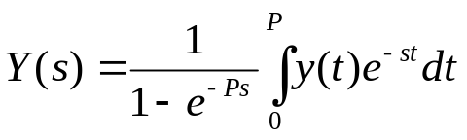
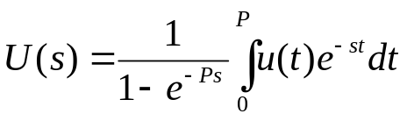
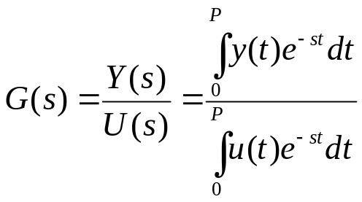
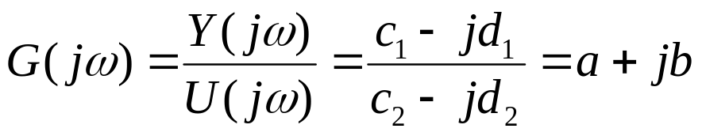
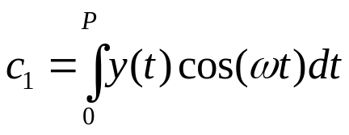
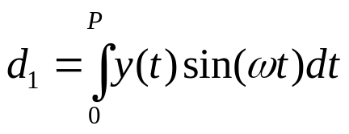
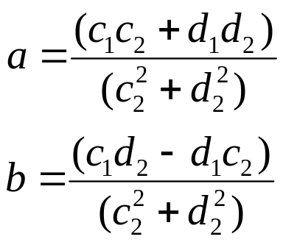
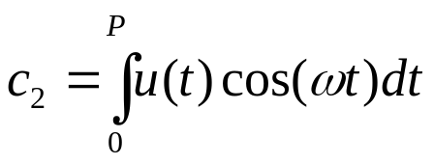
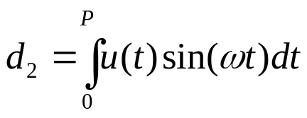
Fourier Transform Method
y(t) and u(t) are piece wise continuous and periodic, Laplace transform
How to find the coefficient?
Process Control
Dr. Cai Wenjian

Slide 12

Recursive Solution
Take N samples for one period, for given
calculate
Process Control
Dr. Cai Wenjian

Slide 13





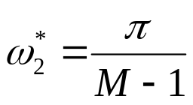
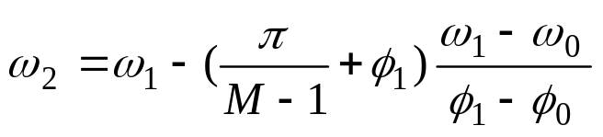
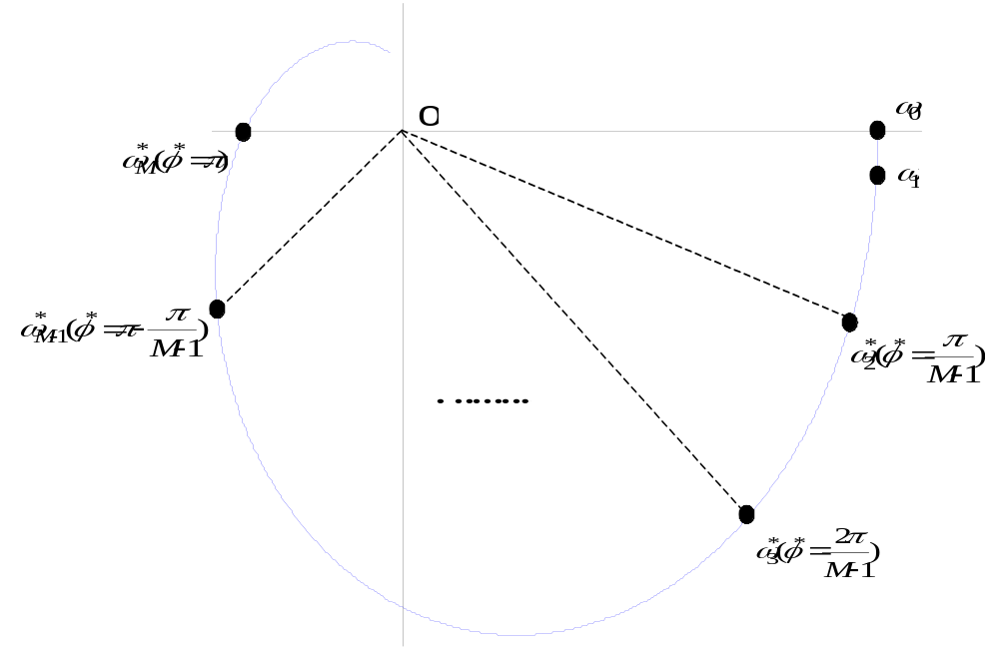



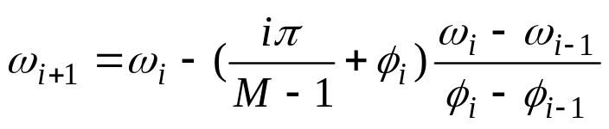


Recursive Solution
For initial values
are zeros
calculate
Obtain the frequency by
(close to the desired frequency)
calculate
For
and
Process Control
Dr. Cai Wenjian

Slide 14
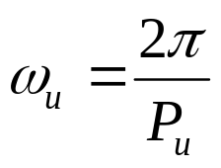
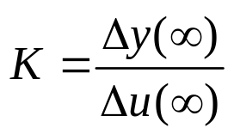
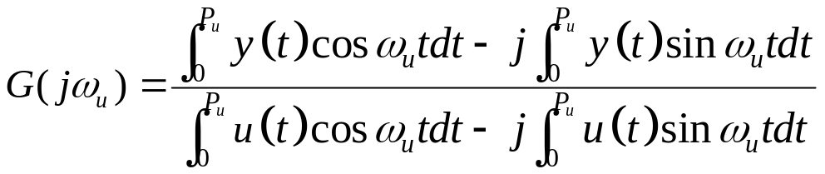
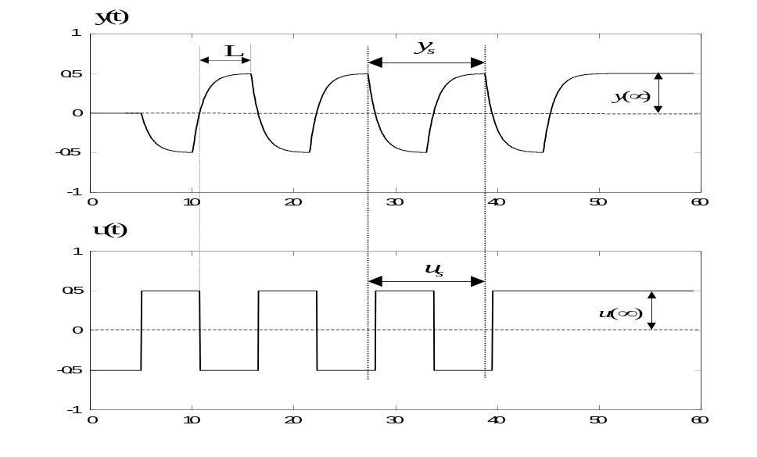
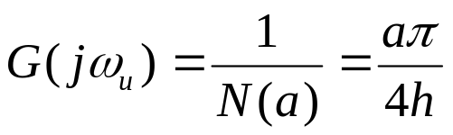

Relay Plus Step
From relay
From Step
or simply but less accurately
L read off from relay test
Process Control
Dr. Cai Wenjian

Slide 15
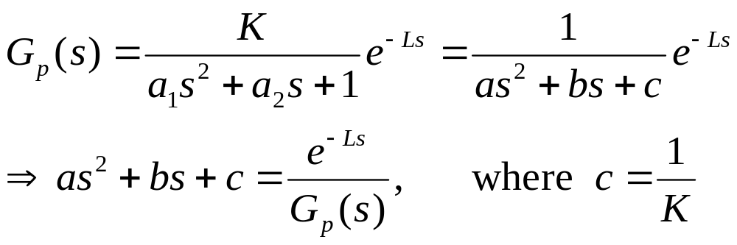
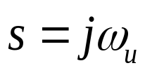
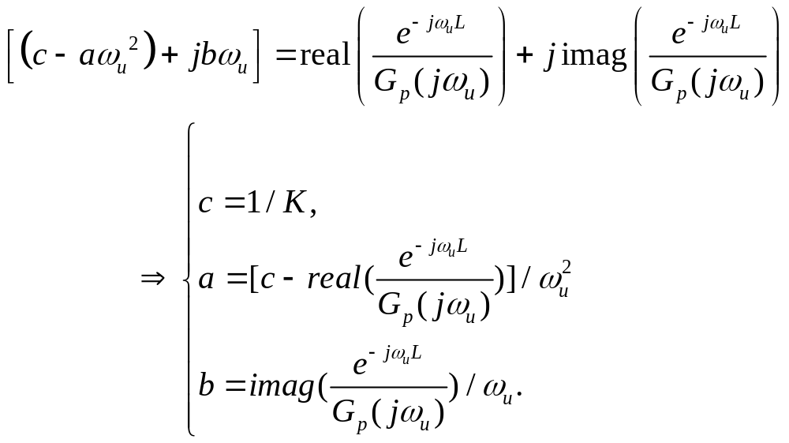
Relay Plus Step
SOPTD model
Replace
Process Control
Dr. Cai Wenjian

Slide 16
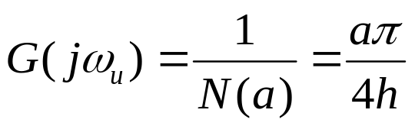
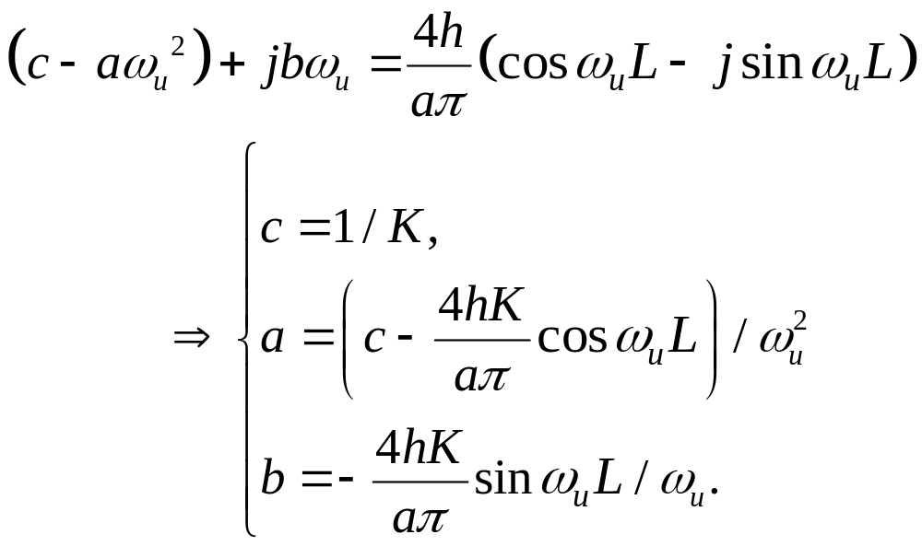
Relay Plus Step
For
Process Control
Dr. Cai Wenjian

Slide 17
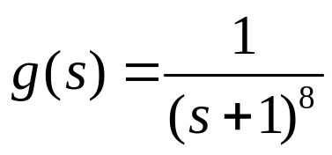
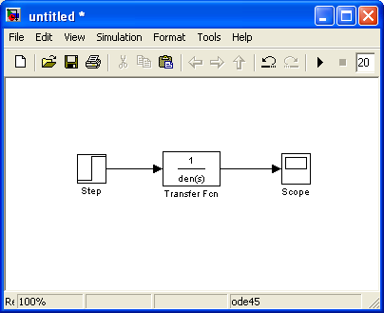
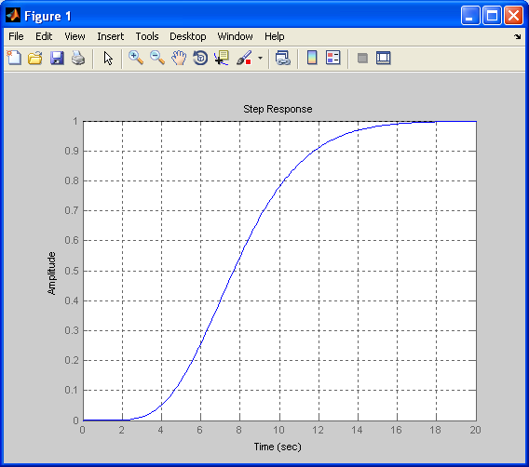
Working Example
Process Control
Prof. Cai Wenjian

Slide 18
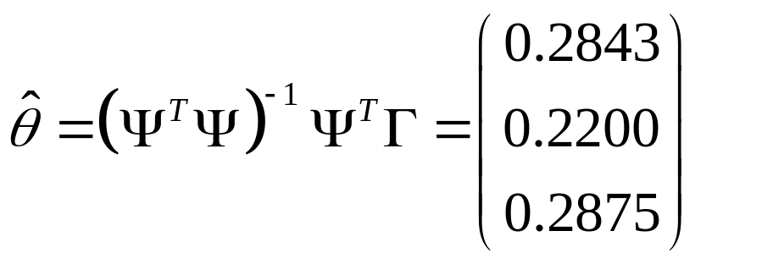



Least Squares Method in Time Domain
N = 30
Sampling: (start after apparent time delay) 4 to 34,
Sampling time: 1s
30×3 matrix
30×1 vector
Process Control
Prof. Cai Wenjian

Slide 19
Least Squares Method in Frequency Domain
Sampling: (start after apparent time delay) 4 to 34,
Sampling time: 1s (same as time-domain)
Initialization: w₀=0, and w₁,then calculate G(jw_{i}) by integration
For each G(jw_{i}), find phase and magnitude by angle function and abs function.
Recursively calculate w_{i+1}
Recursive solve magnitude and phase(set M=8 to15 for a reasonable estimation result).
Use the magnitude condition and least square method to construct Γ matrix and Φ matrix to calculate θ matrix
Calculate model parameters a₁, a₂, b₁, b₀ from θ
N = 30
Process Control
Prof. Cai Wenjian

Slide 20



Working Example
Process Control
Prof. Cai Wenjian

Slide 21







Three Parameter Model
Reading:
Process Control
Prof. Cai Wenjian

Slide 22
Frequency Method
Same as frequency domain method for step input,
Your encouraged to try this method.
Process Control
Prof. Cai Wenjian

Slide 23


Model verification
Process Control
Prof. Cai Wenjian

